Slide 1
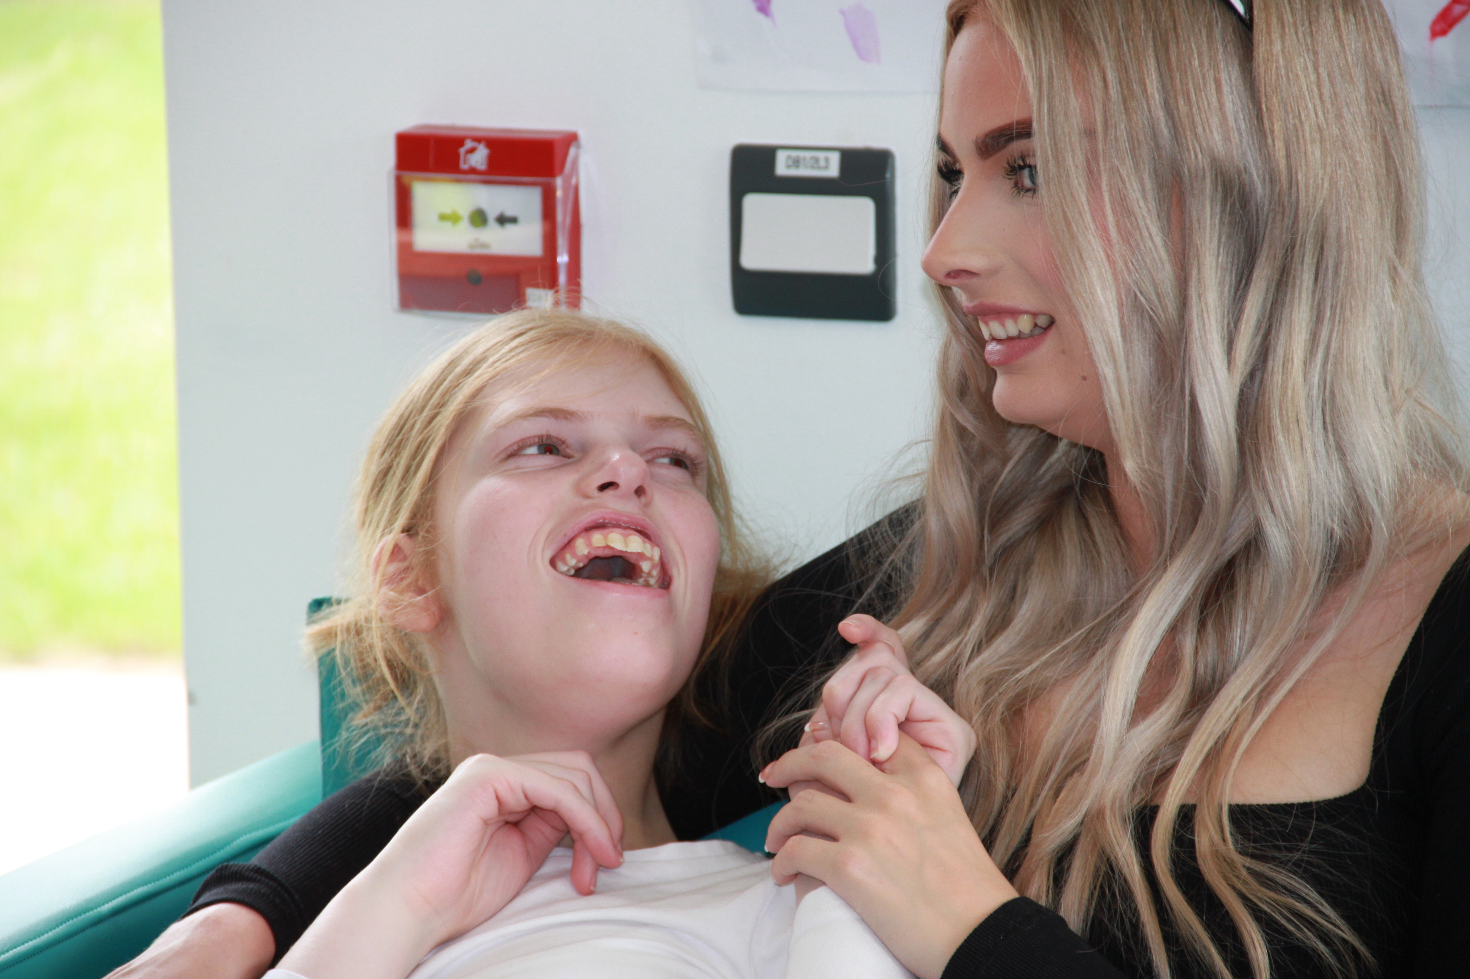


What Matters to Me
Influencing policy with the experiences, preferences and views of young people with severe or profound and multiple learning disabilities
The Importance of seeking ALL views
©The Challenging Behaviour Foundation 2023
info@thecbf.org.uk
www.challengingbehaviourfoundation.org.uk

Slide 2


What Matters to Me…what's it all about?
  Using direct engagement to seek the experiences, preference and views of young people with severe or profound and multiple learning disabilities (PMLD) and using what we learn to influence policy and shape support and services
  Focusing on a group of young people who can often be overlooked in consultations or decision-making processes because they communicate in alternative ways such as through body language, facial expressions or using signs and symbols
This presentation aims to achieve the following:
    Highlight the value and importance of ensuring everyone has opportunities to influence, make choices and be consulted with
    Shares ideas of how to include people with severe or PMLD in engagement
    Considers the barriers and challenges
    Inspire services and organisations to reflect on and improve the way they seek the views of people with severe or PMLD

Slide 3


Why is this important?
For people with severe or profound and multiple learning disabilties:
  Because it is their right!
  Improves the services and support they receive
  Provides more person-centred care
  Sense of autonomy and control in influencing their lives
  They will likely rely heavily on accessing statutory services, they should be involved in shaping that when public consultations are run
For organisations or services:
  Embeds a culture of true co-production and meaningful engagement
  Improves the services and support they deliver
  Fosters trust and builds relationships
And because it’s the law.......
Children and Families Act 2014 – Local Authorities should ensure that children, their parents and young people are involved in discussions and decisions about their individual support and local provision.
The Equality Act 2010 – Disabled children and young people are not discriminated against and have equal opportunities to participate in all aspects of life.

Slide 4
Initial thoughts....
  What steps are in place already for you to engage with severe or profound and multiple learning disabilities?
  Is there representation on voice boards/learning disability partnership boards/forums (or equivalent)
  Could this be expanded on?
  How inclusive are your public consultations? Are they restricted to just online/written/verbal contributions?
Use the What Matters to Me reflection checklist to think about this in more detail
(not all above will be relevant – apply to your area of practice)

Slide 5

How could we do it?
1
Learn about the person
Use these helpful resources
Finding out what matters
2
Spend time and observe
A Guide on Consent and Best Interest
What Matters to Me Methodology
Principles of Engagement
Direct Engagement Activities
3
Activities together
4
Review and check

Slide 6

Barriers & Challenges
What Matters to Me was a 3-year project focused on engaging with young people with severe or profound and multiple learning disabilities. We recognise that in day to day life there are genuine barriers to being able to engage meaningfully with this group in consultations. Time, resources and funding often being key factors out of the control of the professionals carrying out the engagement directly.
Key Points:
  Champion for the resources and time to be made available to engage with this group – it is important! and these shouldn’t be the reason an individual is unable to share their views or be involved in decision-making.
  If there are barriers to engagement being able to be carried out thoroughly – recognise and highlight this, but then consider alternative ways to still gather input from people with severe or profound and multiple learning disabilities. Doing something is better than doing nothing!

Slide 7
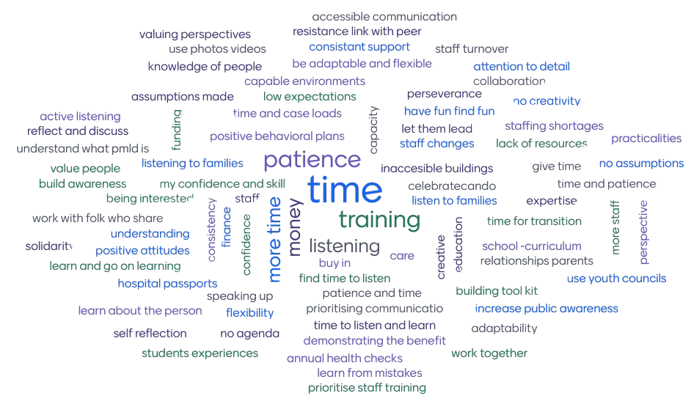
Barriers and challenges that attendees at our online launch event felt impacted meaningful engagement with people with severe or profound and multiple learning disabilities

Slide 8

The Principles of Meaningful Engagement

Slide 9
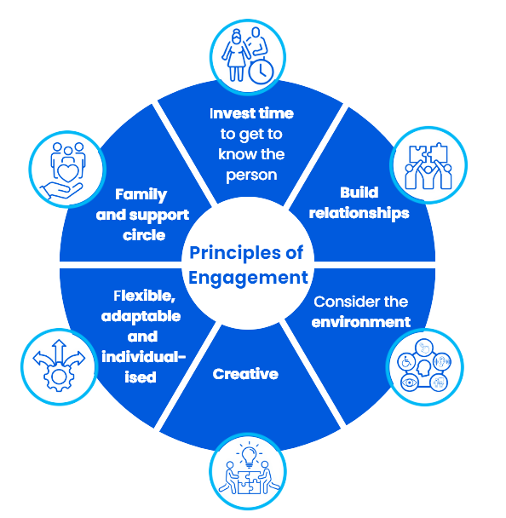
Finding out what matters
Principles of Meaningful Engagement
Direct engagement with people with severe or profound and multiple learning disabilities does take time, skills and resources to be done in a meaningful way.
But this shouldn’t be a reason not to engage this group at all.
Working with a smaller number of people to represent engagement with young people with severe or profound and multiple learning disabilities, is better than not consulting them at all.
Principles that are important to be considered and followed to engage in a meaningful way with young people with severe or profound and multiple learning disabilities

Slide 10
Circles of Influencing
We can all play a role in facilitating everyone to have the opportunities to influence the
world around them and the services and support they access.
Systemic Changes, National Bodies, Government Policies
Consultations need to go far enough to seek the views of people who do not communicate through speaking or writing.
Policies, guidance
and legislation
Organisations,
services and support around an Individual
Local Authorities, ICBs, NHS Trusts, Service providers and Education providers
Methods can be used to gather experiences and preferences to shape systems change.
Individuals
daily life
Key people, activities, interests and support and services
The experiences, preferences
and views of
an Individual
What is important to and for the individual, this should infleunce other circles

Slide 11
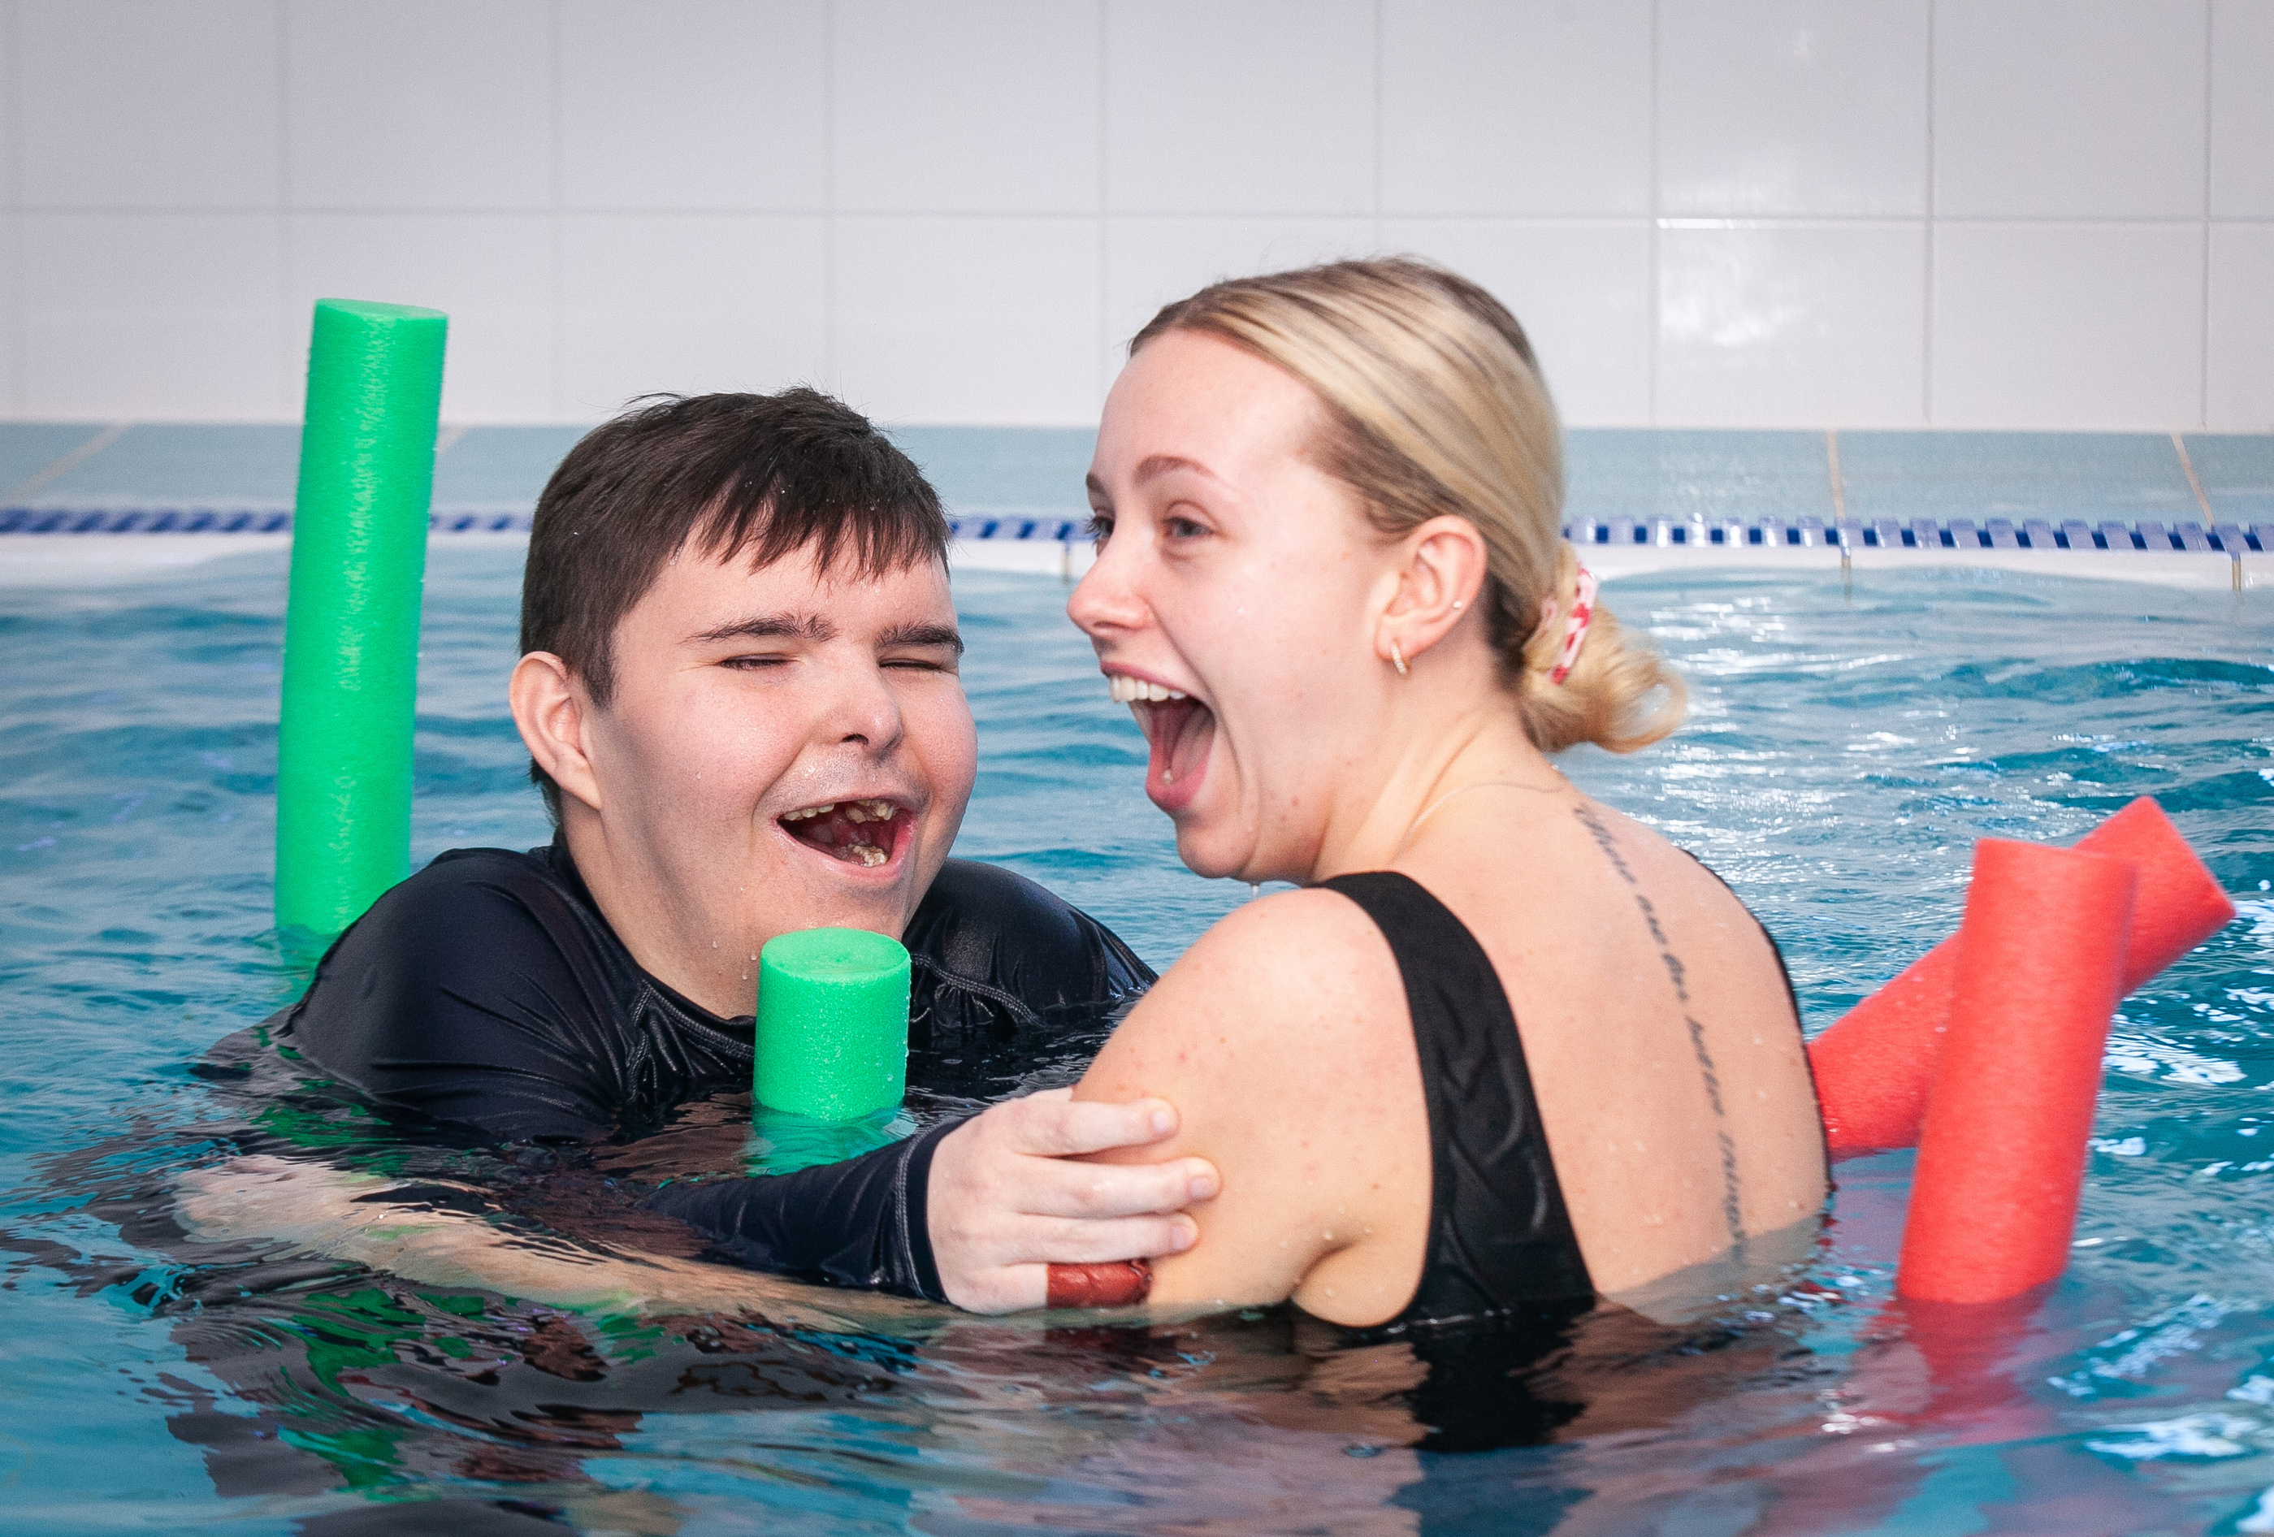

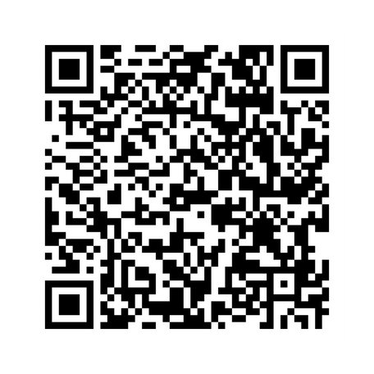
For more information
For more information and other practical resources, please visit the What Matters to Me webpage:
https://www.challengingbehaviour.org.uk/what-we-do/projects-and-research/what-matters-to-me/

Slide 12



Every human being should be able to give their view or opinions and make the decisions and choices that they want to. Just because it is difficult for a young person to communicate doesn't mean their views and thoughts should be ignored or not attempted to get.
Family Carer

Slide 13

info@thecbf.org.uk www.challengingbehaviour.org.uk
©The Challenging Behaviour Foundation 2023

